Slide 1
Client and matter risk assessments
Declan Brown, AML Regulatory Manager
Michelle Clement, AML Regulatory Manager

Slide 2
Why is it important?
Regulatory requirement
Decide whether to accept instructions
Decide level of client due diligence required
Promote good business
Financial sanctions risks

Slide 3
Thematic review
94% of firms had a process
Nearly half (47%) files didn’t have a client/matter risk assessment
Outcomes

Slide 4
What it isn’t!
E-verification system rating
Business risk assessment
‘red tape’ exercise

Slide 5
Good Practice
Recording rationale
Tailored templates
Review at appropriate intervals

Slide 6
SRA Template
ABC LLP is a law firm based in Bristol
Client based in Birmingham
£250,000 residential property purchase in Birmingham
£25,000 deposit from client, alongside £225,000 mortgage

Slide 7
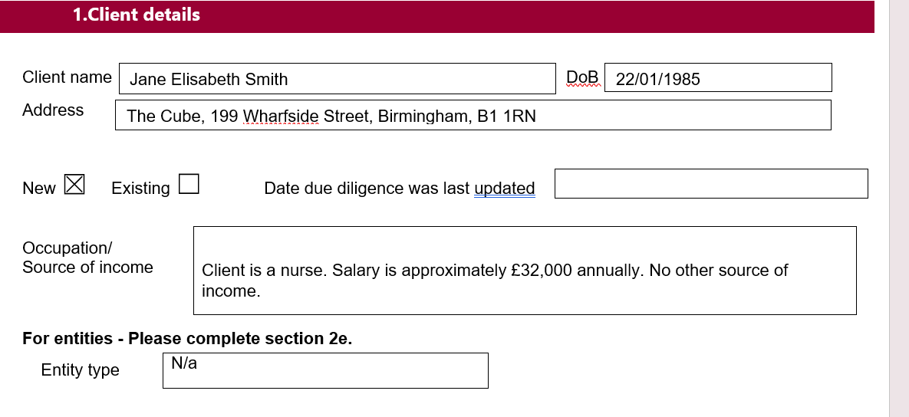

Slide 8
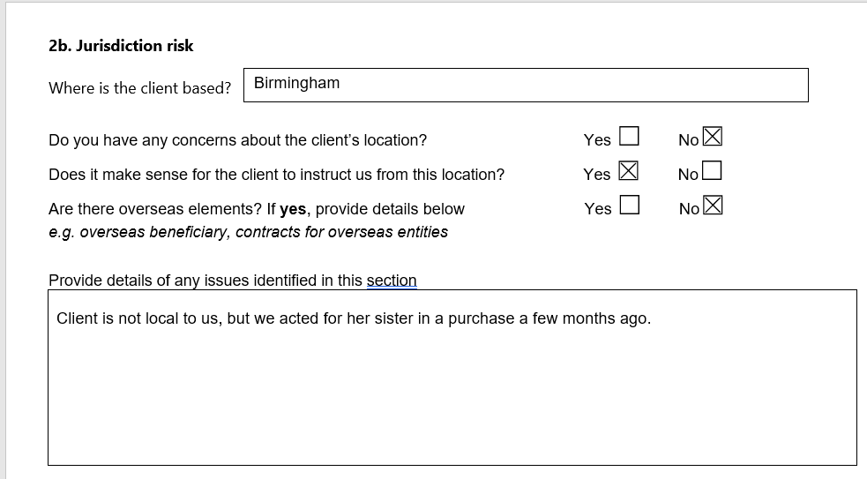
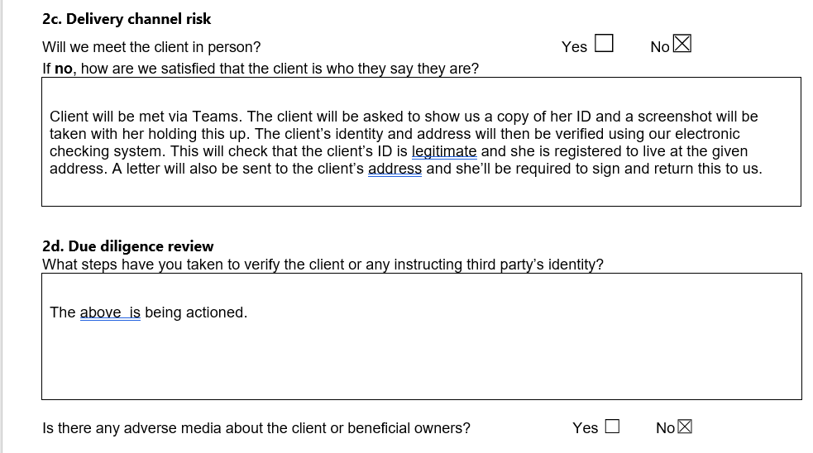

Slide 9
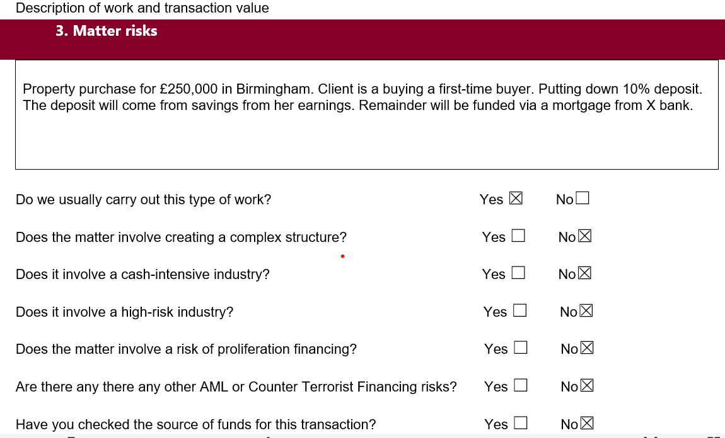

Slide 10
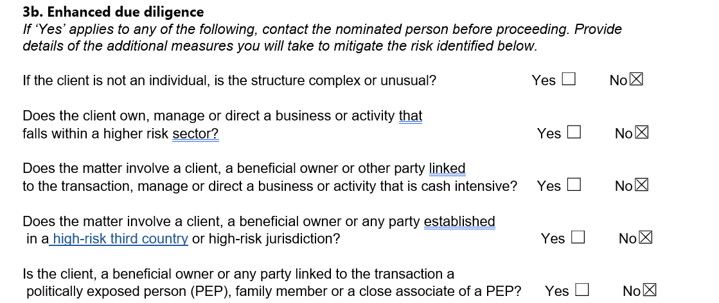

Slide 11
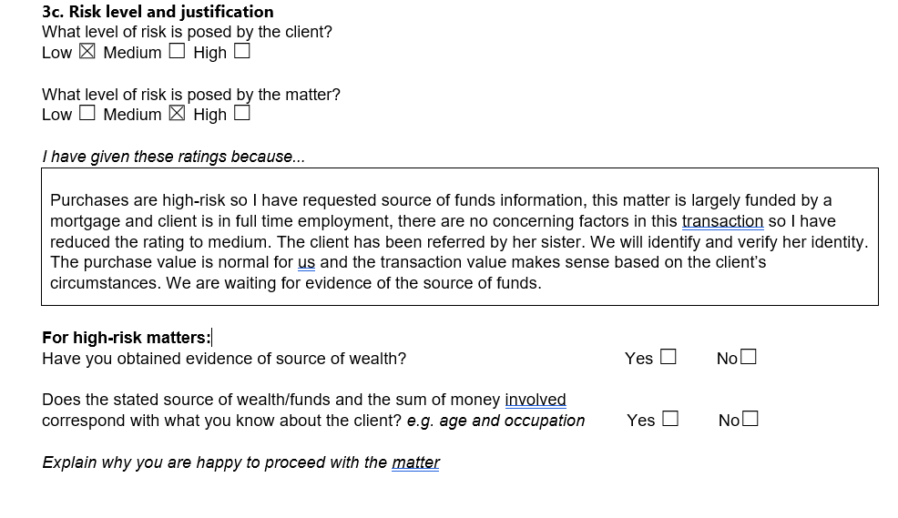
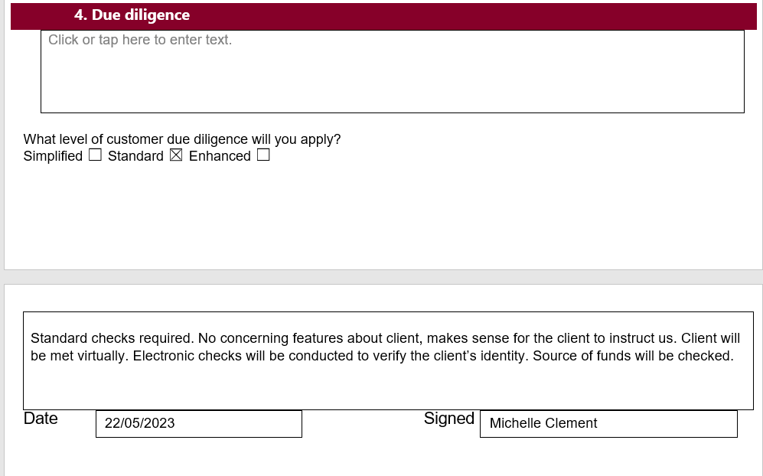

Slide 12
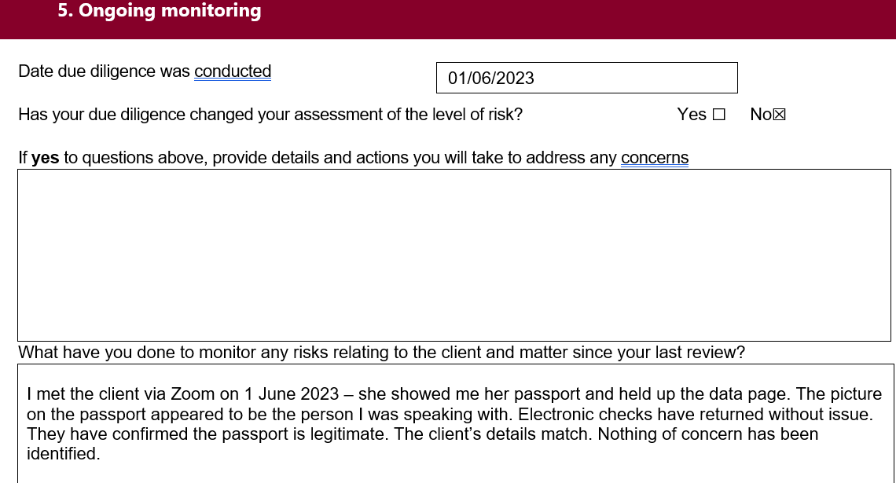

Slide 13
Key takeaways
Do it every client, for every matter in scope of the MLR
Make sure the relevant people know how to access it
Make sure the relevant people can read and understand it
Write it down

